Slide 1
TOPIC 7:
CONTROL SYSTEMS
LESSON 7-4
DISTRIBUTED SYSTEMS

Slide 2
AGENDA
Centrailized Systems
Distributed Systems
Agents
Effectors
Environments
Use cases of agents
NOTE!
Have a way to take notes available for this lesson

Slide 3

THE WARM UP QUESTION
Each set of traffic lights in a city is controlled by a separate embedded system.
It has been proposed that all the traffic lights in the city should be controlled from a central computer.
Explain the benefit for drivers of having access to real-time information about traffic and road conditions.

Slide 4
THE WARM UP ANSWER
Good answers:
Reduce accidents/improve safety
Optimize traffic flow
Warn drivers about traffic incidents
Insights into congestion/delays allow city to improve roads

Slide 5
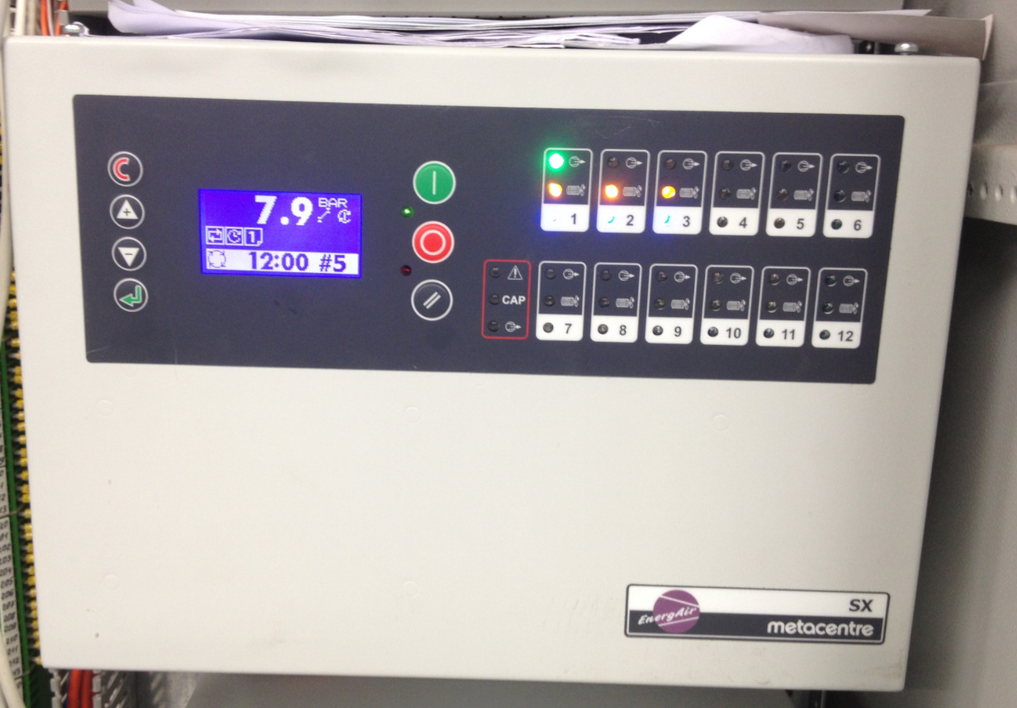
CENTRALLY CONTROLLED SYSTEMS
Most of the systems we’ve discussed today are centrally controlled
Centrally controlled systems – have a dedicated computer system responsible for all necessary calculations that the system uses to function

Slide 6
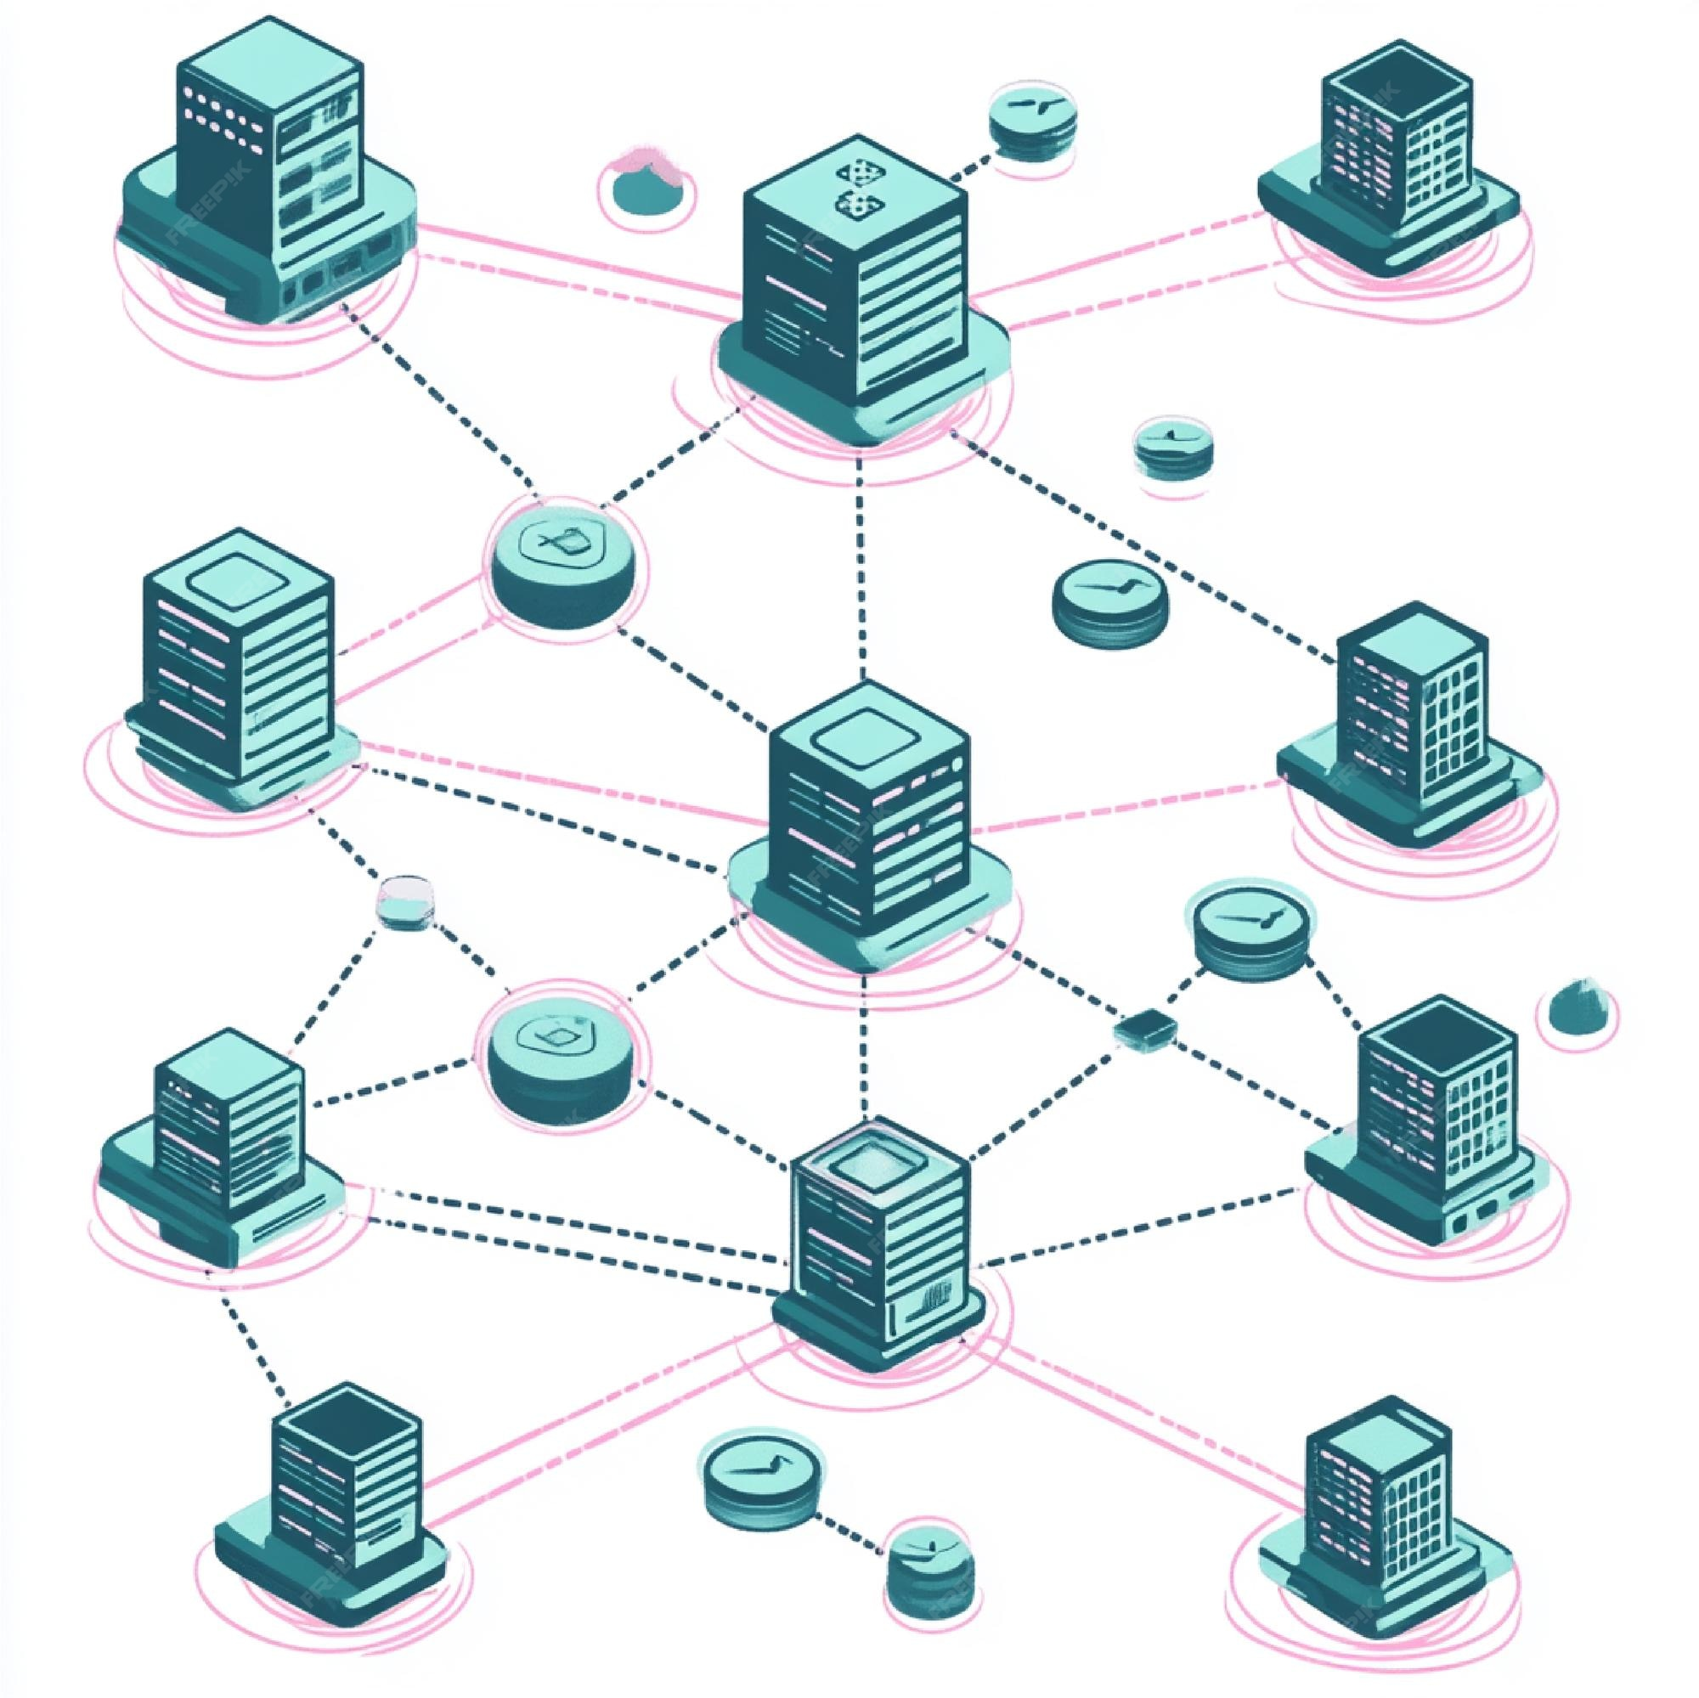
DISTRIBUTED SYSTEMS
But there is another kind, the distributed system
Distributed System – have multiple computers, with each one doing part of the necessary calculations, and anything else the system needs to function

Slide 7
ADVANTAGES
Centralized Systems:
All resources in single system
Usually cheaper to operate and setup
More security for all data (less places to hack)
Less overhead
Simpler backups
Distributed
Each system has necessary resources
No catastrophic failure if the connections are severed somehow
Very easy to expand
Add/remove parts as needed

Slide 8
DISADVANTAGES
Centralized Systems:
If any clients exist, they must connect to the central system
Making connection a point of failure
If the single computer fails, the whole system goes down
Distributed
Expensive to set up because of additional hardware
Backup requires more effort at each site
Security – if one node is compromised they all can be

Slide 9
COST COMPARISON
Cost is one of the biggest factors in picking between centralized and distributed
Centralized: requires a powerful central computer
Distributed: requires a number of computers
Maintenance for either could cost more depending on specific implementation details
So neither is a clear winner

Slide 10
TRAFFIC LIGHT COMPARISON
Centralized Systems:
Lights between intersections need to communicate
If communication is lost with central computer, the whole system may go down
Central computer can only handle so many traffic lights at once before overloading
Distributed
Can operate when main computer goes down
Expansion is easy, adding new lights will not overwhelm computer
Centralized surveillance/algorithms not always available
But can be substituted

Slide 11
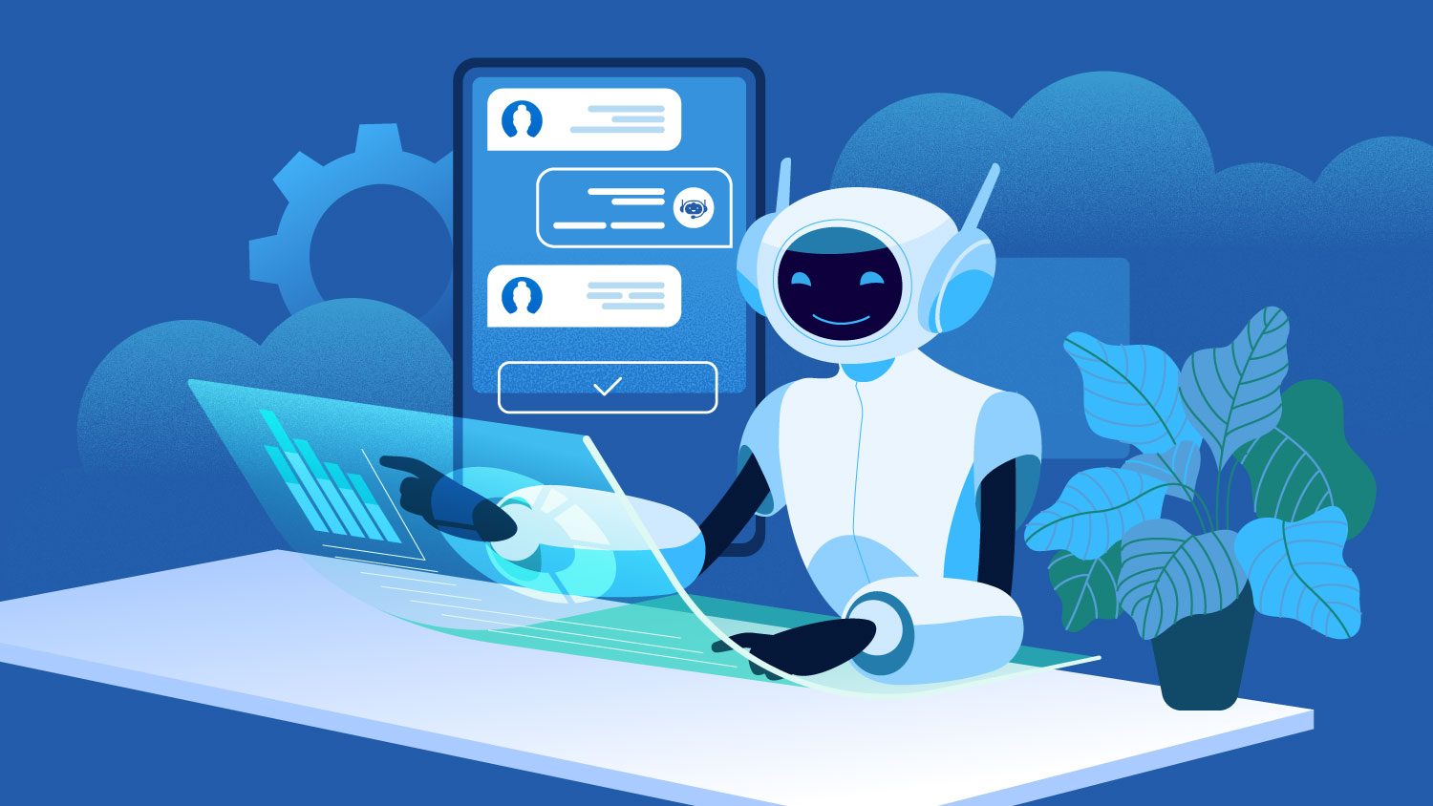
AUTONOMOUS AGENTS
Autonomous agents:
Agents are anything that can perceive its environment through sensors and act upon it through effectors
Humans are agents
Robots are agents (if they move autonomously)
Programs are agents if they respond in real time

Slide 12
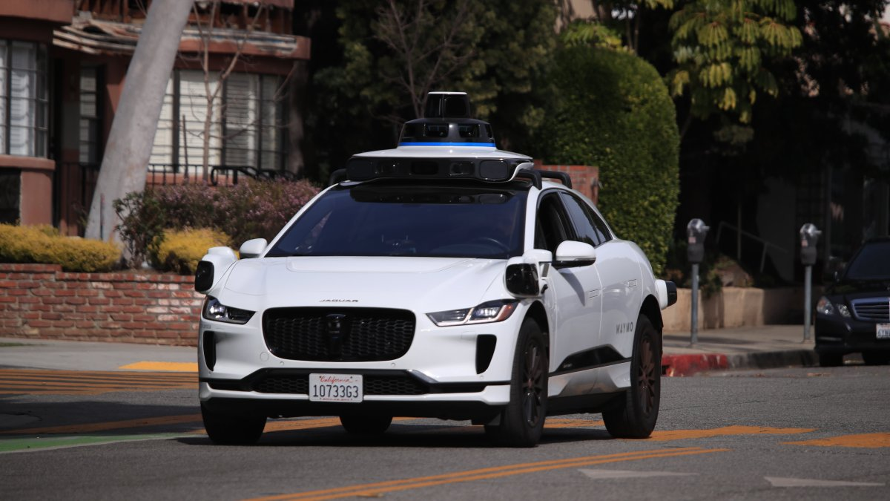
AUTONOMOUS AGENTS
Agents operate on behalf of an owner with a degree of autonomy
They follow algorithms supplied by the owner
Self driving cars
Programs that search the world-wide web
Computer viruses

Slide 13

AUTONOMOUS AGENTS
Environments can impact agents
They can be accessible or inaccessible
They generally cannot see every part of their environment, just a subset of it
An environment may be deterministic or non-deterministic
Are agent’s actions pre-defined with no possibility of uncertainty?
Is ChatGPT deterministic or not?

Slide 14
AUTONOMOUS AGENTS
Environments may be episodic or non-episodic
Are the agent’s actions based on their previous actions, or are they segmented entirely?
Environments can be static or dynamic
Do they change or not while an agent is deliberating an action?
Environments may be discrete or continuous
Is there a finite number of states it can be in
Which of these categories does the real world generally fall into?

Slide 15
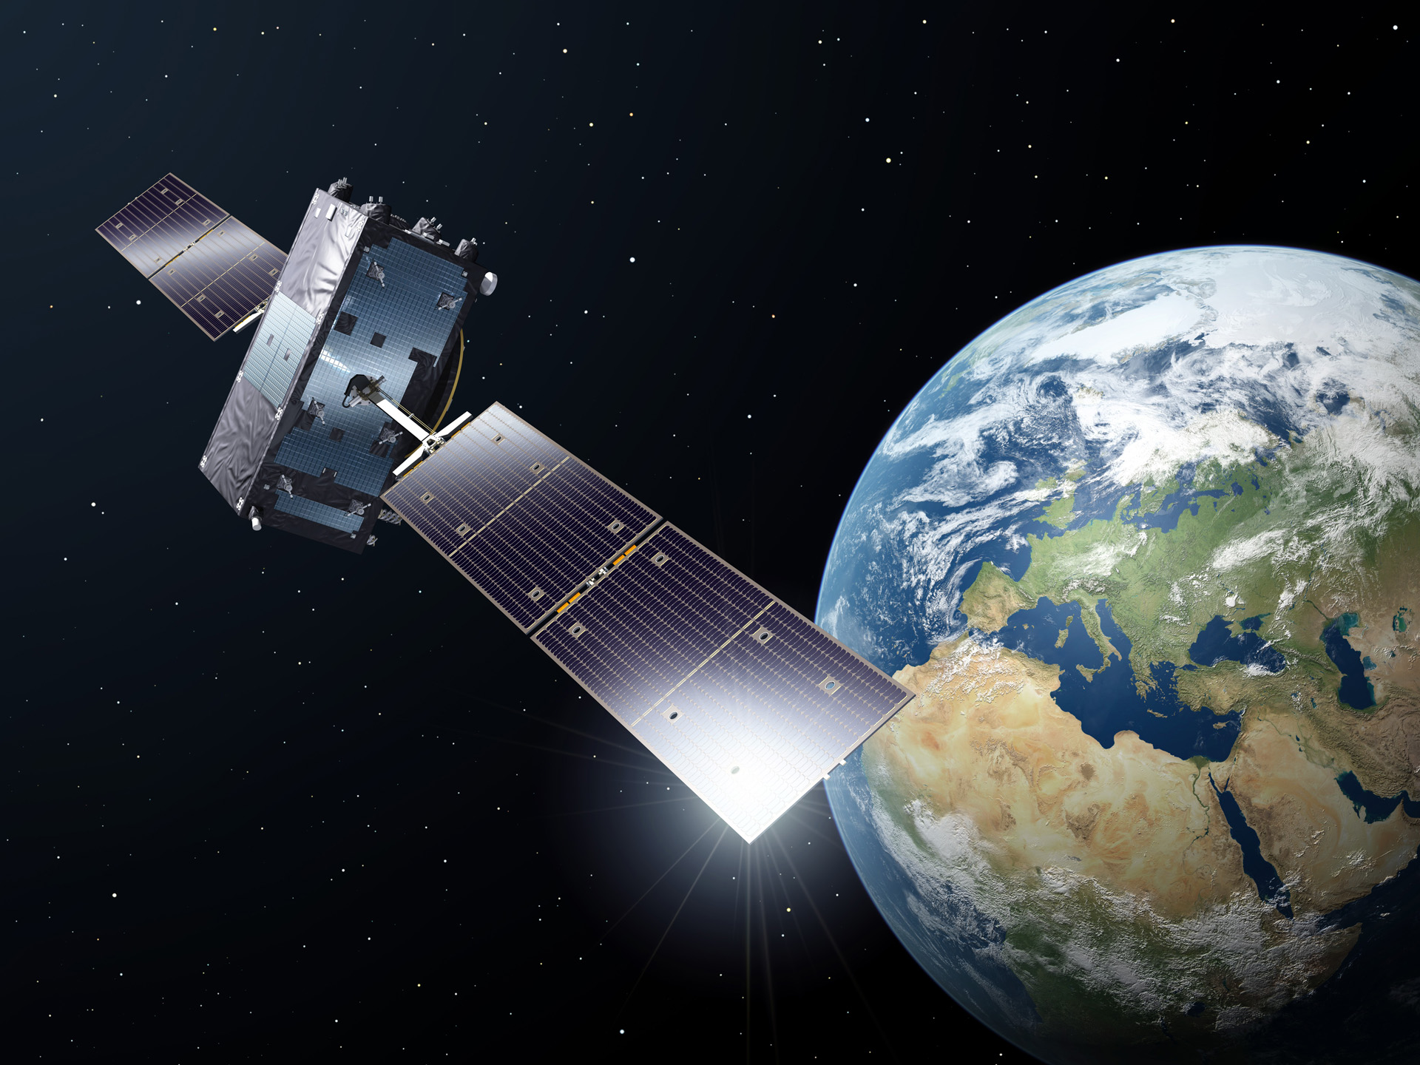
USE CASES
Space missions
Missions may be manned or unmanned
Satellites operate generally entirely autonomously
Rovers operate often without human interference
Entire ships can be launched without needing a person onboard
Most mistakes made during manned missions are mad eby humans
Autonomous agents don’t get tired or forget things

Slide 16
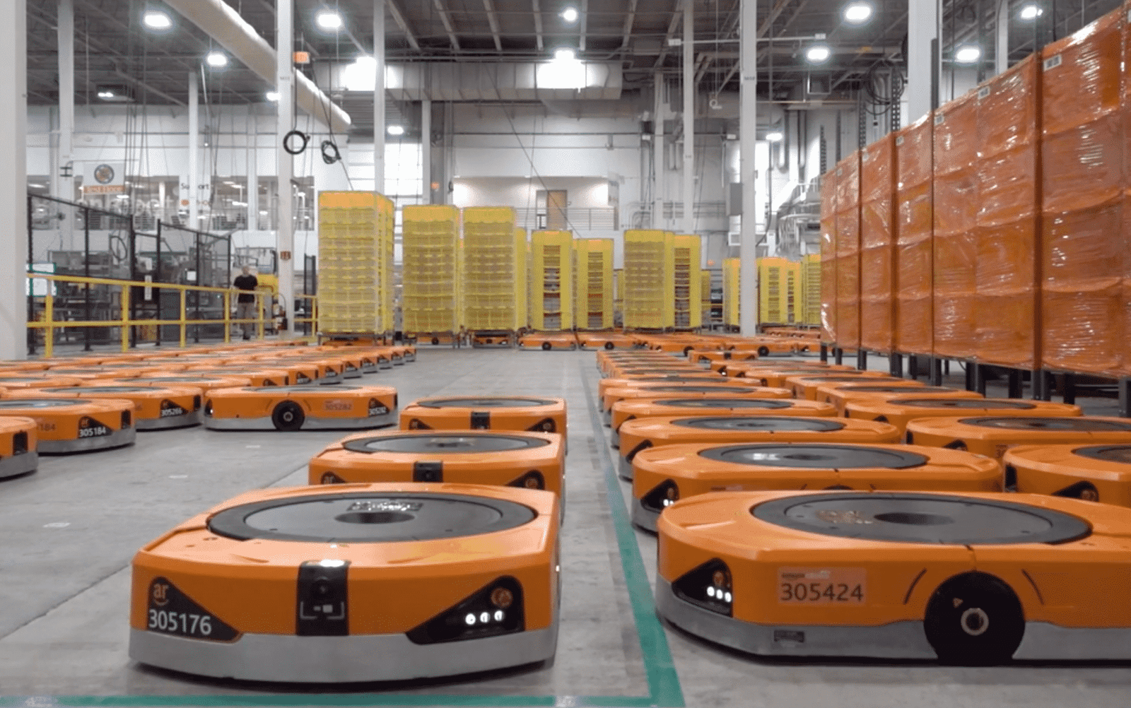
USE CASES
Warehouses
Amazon already uses robots in their warehouses
Carry boxes or shelves of products
Ships far more people than human workers could alone
Amazon ran a contest called the Amazon Picking Challenge where researchers competed to build the best robot
There is a lot of innovation in the automation scene for things like this

Slide 17
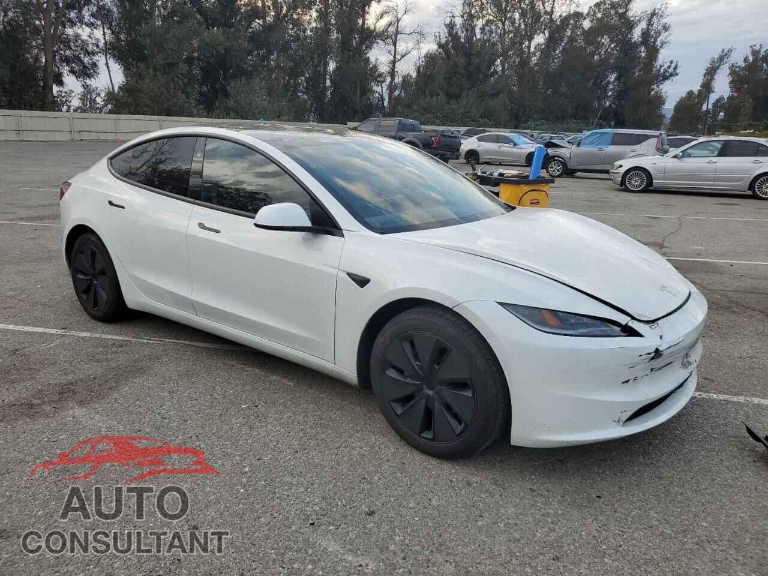
USE CASES
Cars
Self driving cars are kind-of, almost upon us
Work in both urban and rural settings
Agents use sensors to detect information about the car’s current state, as well as the environment
Agents should act in an inaccessible, non-deterministic, non-episodic, dynamic, continuous environment

Slide 18
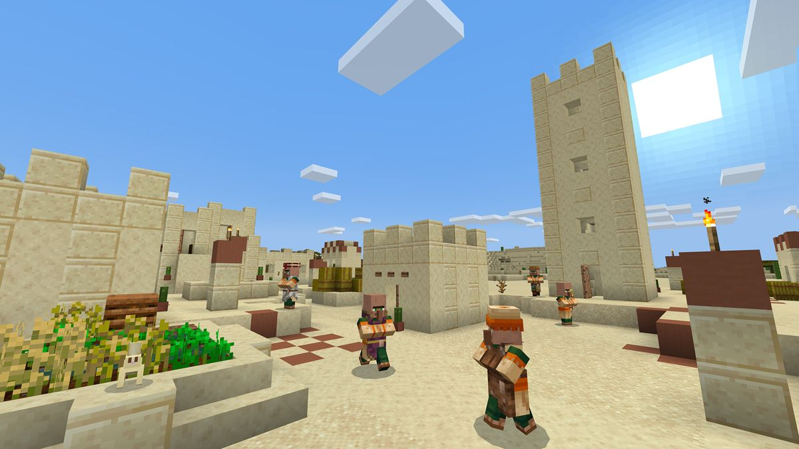
USE CASES
VIDEO GAMES
NPCs react to a more fixed-state in-game world
Entire subsystems in games use agents to determine what happens

Slide 19
REVIEW WORKSHEET
The review for this unit’s quiz is up on Github! Go get ‘em!

Slide 20

VOCAB TO REMEMBER
Agents
Centralized Systems
Distributed Systems

